Slide 1
CSE460: VLSI Design
Lecture 5: Finite State Machines (Part 1)

Slide 2
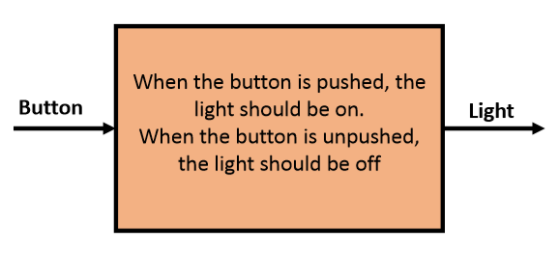
Something We Can Build (So Far)
What if you were given the following design specification:

Slide 3
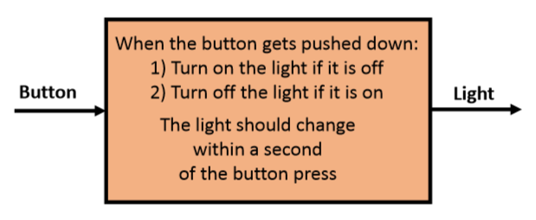
Something We Cannot Build (Yet)
What if you were given the following design specification:
What makes this circuit so different from those we’ve discussed before?

Slide 4
What makes this circuit so different from those we’ve discussed before?
Specifications:
1. “State” –i.e. the circuit has memory (become “state‐ful”) 2. The output was changed by an input “event” (pushing a button) rather than an input “value”

Slide 5
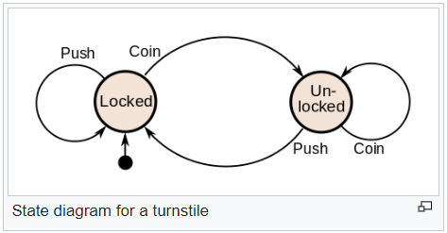

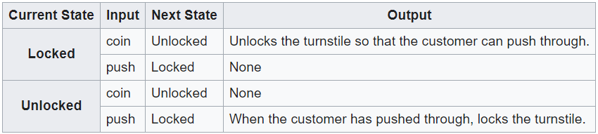
Example 1: An automated gate (Turnstile)

Slide 6
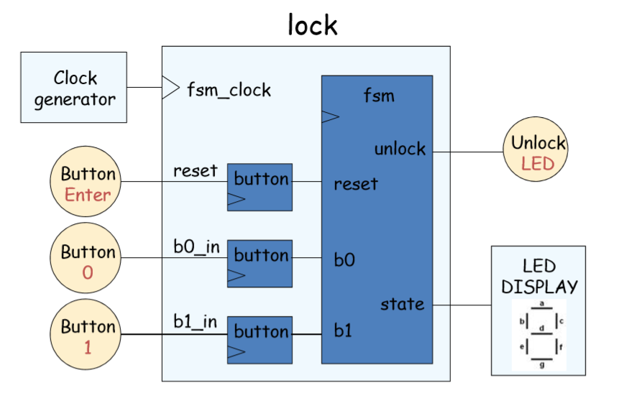
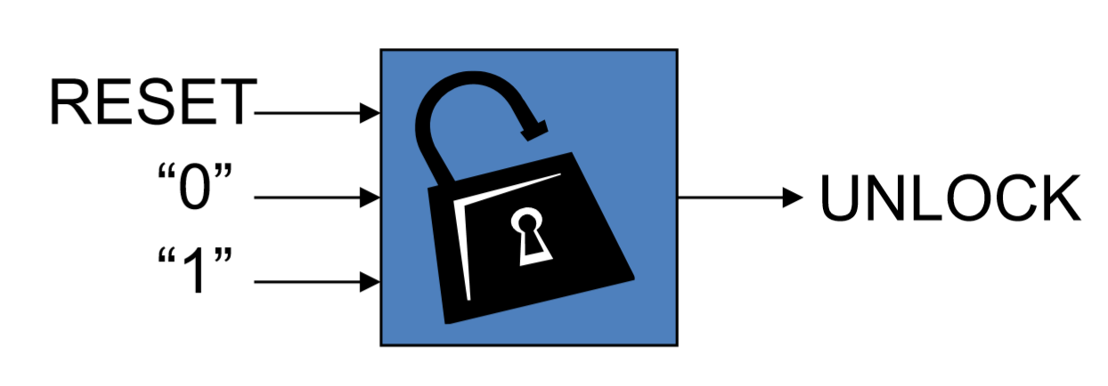
Example 2: Electronic combination lock
The combination should be 01011

Slide 7
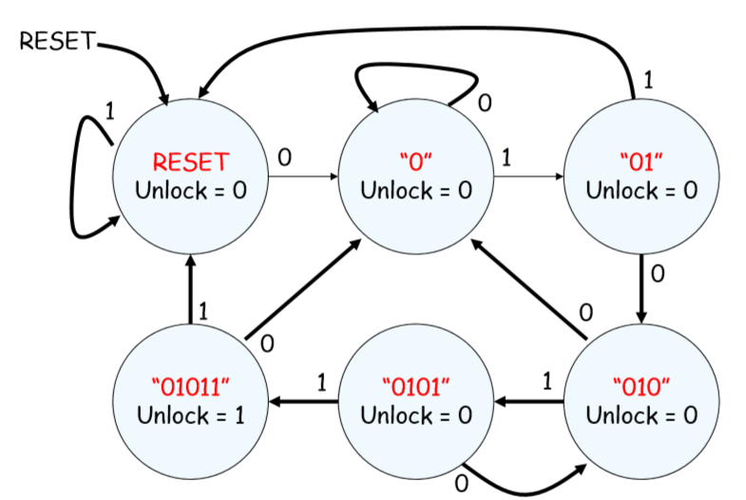
Example 2: Electronic combination lock
6 states -> 3 bits

Slide 8
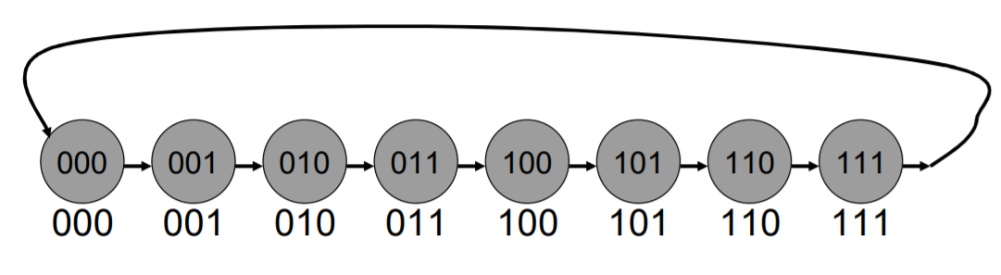
Example 3: Counter
3 bit binary counter

Slide 9
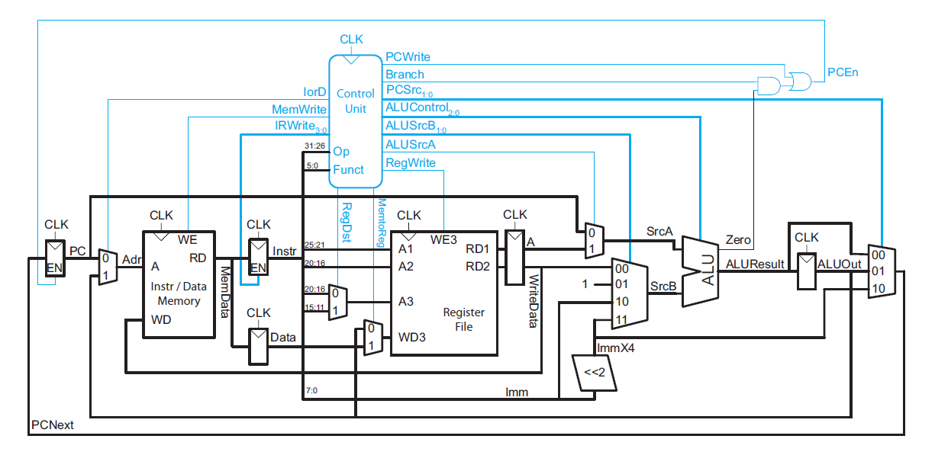
Example 4: Control circuit of a processor
Figure: Multi-cycle MIPS microarchitecture

Slide 10
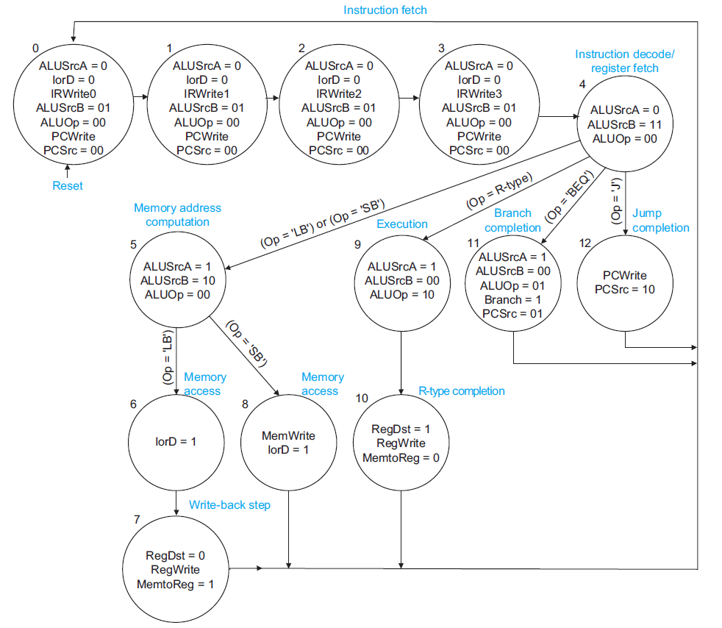
Example 4: Control circuit of a processor
Figure: Multi-cycle MIPS Control FSM

Slide 11
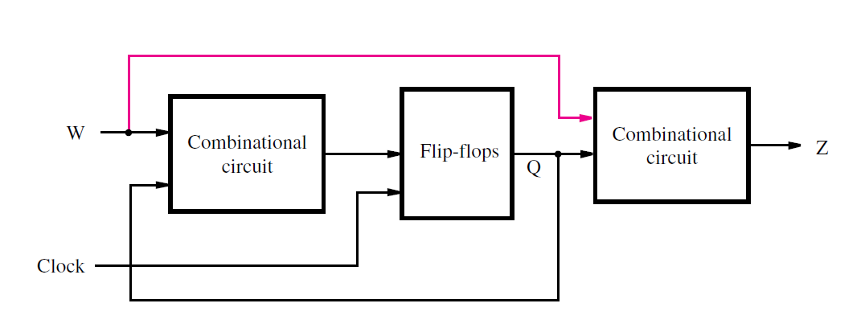
General form of a sequential circuit
W represents input/s
Z represents output/s
Flip-flops are used to save the state of the circuit, Q
Also called Finite State Machine (FSM) or simply, machine
2 types: depending on the connection drawn in pink on the circuit
Figure: General form of a sequential circuit

Slide 12
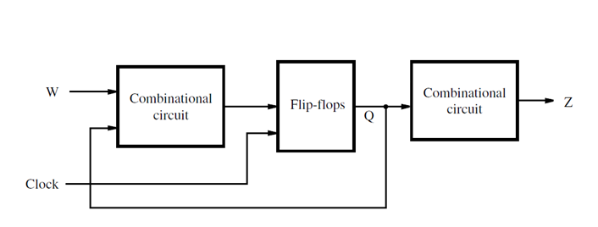
FSM types
Moore type FSM
Output (Z) depends only on the state (Q) of the circuit
Mealy type FSM
Output (Z) depends on both the primary inputs (W) and the state (Q) of the circuit
Figure: Moore type FSM
Figure: Mealy type FSM

Slide 13
Moore vs. Mealy type machines
Moore Machine | Mealy Machine
Output depends only upon the present state. | Output depends both upon the present state and the present input
Generally, it has more states than Mealy Machine. | Generally, it has fewer states than Moore Machine.
The value of the output is a function of the current state and changes at the clock edges | The value of the output is a function of the transitions and changes when the input changes
In Moore machines, more logic is required to decode the outputs resulting in more circuit delays. They generally react one clock cycle later. | Mealy machines react faster to inputs. They generally react in the same clock cycle.

